Slide 1
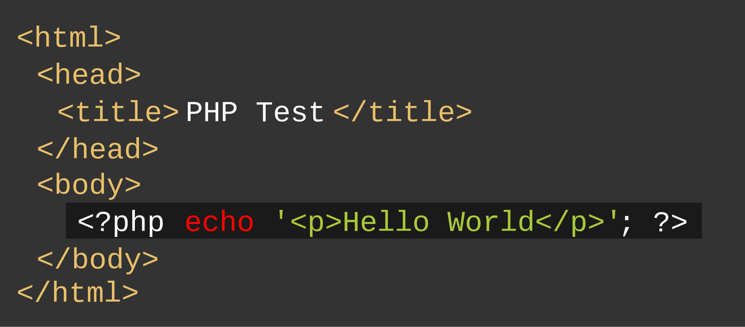
Beyond Hello World: From Scripting to Software
Patrick Schwisow
Madison PHP Conference
September 30, 2016

Slide 2
Introduction
What is a script?
Small Program
Limited Scope
Limited Control Flow
What is software?
Application Design / Architecture
Separation of Concerns
Reusable Components

Slide 3
What Do We Already Know?
Primitive Data Types
Arrays
Variables
Operators
Control Structures
Functions
How to Run PHP

Slide 4

Object-Oriented Programming
Section 1

Slide 5
What is an Object?
Object – A collection of properties and methods.
Property – A variable attached to an object.
Method – A function attached to an object.
Class – A blueprint used to create new objects.

Slide 6
Creating Objects
Constructor – A special function that creates a new object.
Objects are created using the new keyword and a constructor.
Objects can be “stored” in variables using =.
The object itself is stored separately, the variable just points to it.
This pointer to the object is called a reference.

Slide 7
Example 1-1: Creating objects
1
2
3
4
5
6
7
8
9
10
11
12
13
14
15
16
<?php
$object = new stdClass();
$object1 = $object;
$object2 = new stdClass();
var_dump($object);
var_dump($object1);
var_dump($object2);

Slide 8
Copying and Deleting Objects
= does NOT copy objects, it only copies the reference.
Objects can be copied using clone.
Objects are automatically deleted when all references are gone.
Object can be deleted by using unset() on all references.

Slide 9
Example 1-2: Copying and Deleting Objects
1
2
3
4
5
6
7
8
9
10
11
12
13
14
15
16
<?php
$object = new stdClass();
$objectclone = clone $object;
var_dump($object);
var_dump($objectclone);
unset($object);
unset($objectclone);

Slide 10
Creating Classes
Classes are created using the class keyword.
Class names follow the same rules as function names.
Classes should be created before they are used.

Slide 11
Example 1-3: Creating Classes
1
2
3
4
5
6
7
8
9
10
11
12
13
14
15
16
<?php
class Foobar
{
}
$object = new Foobar();
var_dump($object);

Slide 12
Properties and Methods: Visibility
Every property and method has a visibility.
Visibility determines where the property/method can be used.
Visibility can be public, private, or protected.
public – accessible from anywhere
private – only accessible from the object’s methods
protected – similar to private, preferred because reasons

Slide 13
Properties
Defined using a visibility, a name, and optionally a default value.
If no value is given, the default is null.
Naming rules are the same as variables.
Accessed using the -> operator, used just like variables.
$ is used for defining, not used for accessing.
foreach can be used to go through an object’s properties.

Slide 14
Methods
Defined just like a function, but with a visibility.
Naming rules are the same as functions.
Called using the -> operator, used just like functions.
Constructor must be named __construct, cannot return anything.

Slide 15
$this
Methods have access to a special variable: $this.
$this is used to access the current object.
Can be used with -> to access other methods and properties.

Slide 16
Example 1-4: Properties and Methods
1
2
3
4
5
6
7
8
9
10
11
12
13
14
15
16
<?php
class Foobar
{
protected $property = "abcdef";
public function __construct() {…}
public function method()
{
echo $this->property;
}
}
// In another file:
$object = new Foobar();
$object->method();

Slide 17
Namespaces
Avoid name collisions
PHP’s DateTime vs. MyProject\DateTime
Zend\View\View vs. MyProject\View
Alias
use Phergie\Irc\Plugin\React\Command\CommandEventInterface as EventInterface;
Organize / group related classes together

Slide 18
Example 1-5: Namespaces
1
2
3
4
5
6
7
8
9
10
11
12
13
14
15
16
<?php
namespace PSchwisow\FooProject;
use PSchwisow\Other\MyClass;
use PSchwisow\Other\Foobar as OtherFoo;
class Foobar {
public function method() {
$o1 = new \DateTime(); //global namespace
$o2 = new Baz(); //current namespace
$o3 = new MyClass(); //imported namespace
$o3 = new OtherFoo(); //aliased
}
}
// In another file (with no namespace set):
$object = new PSchwisow\FooProject\Foobar();

Slide 19
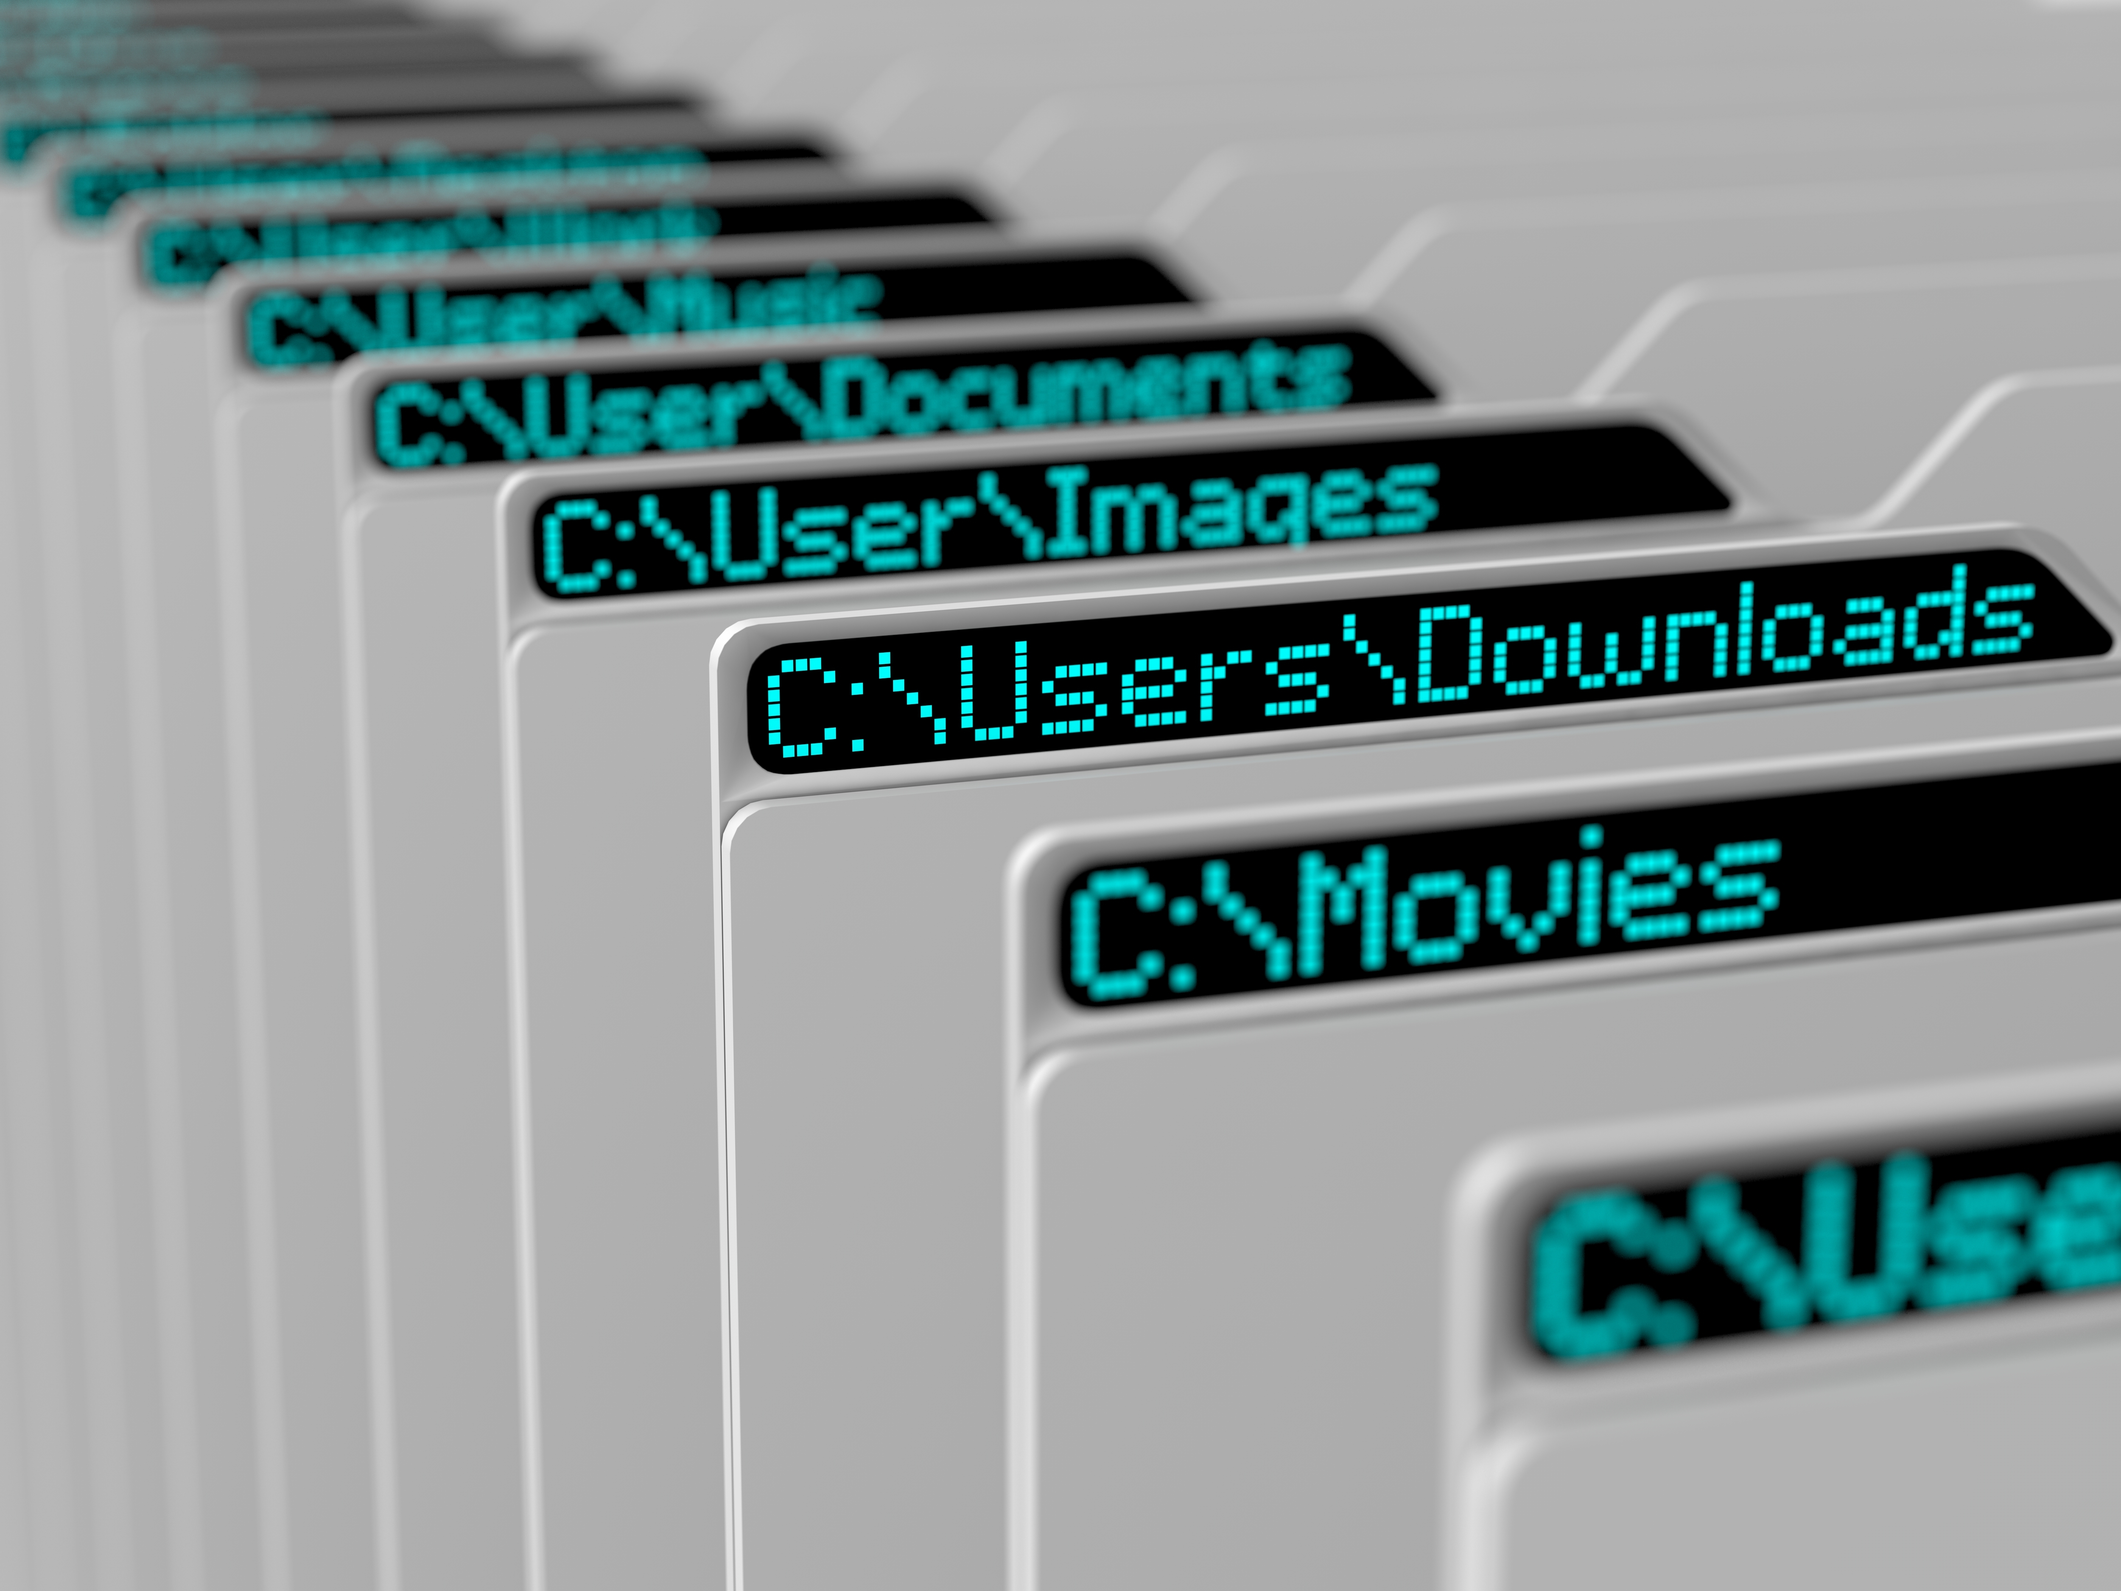
File Layout and Organization
Section 2

Slide 20
File Layout and Organization
How do PHP developers tend to lay out their projects in files and directories?
How do we organize the parts of our applications?
How do we allow our applications to expand?
Notes:
A big problem many beginning developers have is moving from "I can write some php" to "I can start my own new project in php"
There are a lots of questions that roll into that problem
this is moving beyond a question of "how to program" into "how to architect software" which is a much harder place

Slide 21
Basic Layout
/foo-project
/foo-project/data
/foo-project/config
/foo-project/src
/foo-project/public
Notes:
So this is the basic way in which almost all PHP projects are laid out in this day and age
data is the place where we'll store our database information – this might be used for cache or something else
config is the place to store configuration information
src will be the majority of the actual php code for our application
public is where the information you want to see via the web

Slide 22
The Document Root
The document root is a directory (a folder) that is stored on your host’s servers and that is designated for holding web pages.
For security reasons, ONLY actual files for the user should be present – css, js, images, and the PHP files that control logic.
Other files (configuration, PHP classes) should be parallel to the docroot.
Notes:
First rule of thumb, anything you don’t’ want the user to be able to put into a url and access should NEVER be in your webroot
docroot
if you're doing hosting somewhere you ALWAYS need to know what this is
This is going to be controlled by your server
For the built in server it's controlled by the –t flag

Slide 23
Web Information
/public
/public/css
/public/fonts
/public/images
/public/index.php
Notes:
These are the actual we files we want in our public place
anything that you will need to access via a url – an image, css files, will need to be in this public directory
The second part of this is telling your webserver where this location is
for this, we will need to pass a –t argument

Slide 24
Data Information
/data
/data/cache
/data/tmp
Notes:
Data directories will vary depending on what data is being stored
you might also see temporary directories or cached information
or even more

Slide 25
Configuration
Information that might change
Information that might need to expand
Specific settings for parts of your code

Slide 26
Example 2-1: config/config.php
1
2
3
4
5
6
7
8
9
10
11
12
13
14
15
16
<?php
return [
'name' => 'value'
];
Notes:
So we can actual return an array from a PHP file and store it as a variable
Remember we can have nested arrays as well, so we can have settings specific to just database, or just something else in our configuration file

Slide 27
Example 2-2: public/index.php
1
2
3
4
5
6
7
8
9
10
11
12
13
14
15
16
<?php
$config = include '../config/config.php';
var_dump($config);
Notes:
And this is how we would take our information and "load" it into a php variable in say our index.php file

Slide 28
Application architecture
Section 3

Slide 29
Separating Application Code
Actual HTML output – our View
Logic to act on – our Controller
Data rules and reading/writing – our Model
Notes:
This is often called "Model View Controller" – This is probably and overly simplified term, but we will be splitting up our application into this basic concept
Sometimes these come with other names but in a practical manner almost every application is broken up into the data and where it's stored, the logic of the application, and how our application is displayed

Slide 30
App Layout
/src/Foo/Model
/src/Foo/View
/src/Foo/Controller

Slide 31
Template File
Mainly HTML
Shortcut echo tags
Very little logic
simple conditionals
simple loops
May or may not include other templates
Notes:
so what we're calling a "template" is a small chunk of html that we can echo out PHP and maybe do a little bit of logic on
logic SHOULD be limited to loops (foreach), isset checks, and simple if/else logic
the less logic you have in your templates the happier you'll be

Slide 32
Template Class
Holds the data to display.
Generates HTML to return to web browser.
Has “helpers” for common functionality.
Notes:
We have a very simple template class
we need to be able to give it a template (flename) to generate
we need to be able to give it data to insert into the template
we need to have some helper functionality for things like escaping our output

Slide 33
Example 3-1: src/View/template.html
1
2
3
4
5
6
7
8
9
10
11
12
13
14
15
16
<!doctype html>
<html>
<head>
<title><?= $this->title ?></title>
</head>
<body>
<div>
<?= $this->message ?>
</div>
</body>
</html>
Notes:
So this is a very simple example template file
because we're executing this inside a class method, our data will be properties of the object
we use the PHP short tags which are always available
it's a shortcut to typing <?php echo $this->title ?>
You don't need closing ; when you jump in and out of PHP

Slide 34
Example 3-2: src/View/Template.php
1
2
3
4
5
6
7
8
9
10
11
12
13
14
15
16
<?php
namespace PSchwisow\FooProject\View;
class Template
{
public function render($tpl, $data = [])
{
foreach ($data as $key => $value) {
$this->{$key} = $value;
}
require __DIR__ . '/' . $tpl;
}
}
Notes:
So our template class has a simple "render" method which takes a template filename and renders it

Slide 35
Example 3-3: Using Templates
1
2
3
4
5
6
7
8
9
10
11
12
13
14
15
16
<?php
use PSchwisow\FooProject\View\Template;
$vars = [
'title' => 'Hello and Welcome',
'message' => 'This is my templated app',
];
$template = new Template();
$template->render('template.html', $vars);
Notes:
So basically all we do is set our variables, then render our template

Slide 36
Considerations for Templates
Escaping Output
“Base” templates
Set our template file location
Notes:
So a template class probably needs a way to do a couple of things
First is to have a way to have a "base" template set
these are all considerations for writing a "base" class that will do the template work

Slide 37

dependencies and Composer
Section 4

Slide 38
Dependencies
Library – a collection of code, data, configuration, documentation, etc. that can be reused in multiple projects.
Dependency – something that is required for your project to work correctly.
Libraries
PHP versions
PHP extensions

Slide 39
Composer
You declare your project’s dependencies.
Composer determines what versions to install.
Reads composer.json to find direct dependencies.
Reads composer.json of libraries to find THEIR dependencies.
Repeat until complete (or failure).
Installs into your project’s vendor directory.

Slide 40
Example 4-1: composer.json
1
2
3
4
5
6
7
8
9
10
11
12
13
14
15
16
{
"require": {
"php": ">=5.6.0, <7.0",
"ext-xdebug": "*",
"pschwisow/other": "1.0.*"
}
}

Slide 41
Project Layout with Composer
/foo-project (contains composer.json)
/foo-project/data
/foo-project/config
/foo-project/src
/foo-project/public
/foo-project/vendor
/foo-project/vendor/pschwisow/other

Slide 42
How do we actually use these classes?
require_once '../../../vendor/pschwisow/other/SomeClass.php’;
MAGIC!!!

Slide 43
Autoloading: Not Really Magic
When the PHP interpreter reaches a classname it does not know, the autoloader is triggered to attempt to load it.
Autoloading Strategies:
PSR-4 (recommended)
PSR-0
Classmap
File
Composer automatically generates an autoloader based on your composer.json and those in your dependencies.

Slide 44
Example 4-2: composer.json with autoloader
1
2
3
4
5
6
7
8
9
10
11
12
13
14
15
16
{
"require": {
"pschwisow/other": "1.0.*"
},
"autoload": {
"psr-4": {
"PSchwisow\\FooProject\\": "src/"
}
}
}

Slide 45
Example 4-3: public/index.php
1
2
3
4
5
6
7
8
9
10
11
12
13
14
15
16
<?php
require __DIR__ . '../vendor/autoload.php';
$config = include 'config.php';
$app = new PSchwisow\FooProject\App($config);
$app->run();
Notes:
And this is how we would take our information and "load" it into a php variable in say our index.php file

Slide 46
Composer Commands
php composer.phar install
Installs dependencies (from composer.lock).
Creates composer.lock file.
Creates autoloader files.
php composer.phar update
Installs latest versions of all dependencies.
Updates composer.lock file.
Creates autoloader files.
See https://getcomposer.org/ for more details.

Slide 47

Leveraging Open Source
Section 5

Slide 48
Packagist
Packagist (https://packagist.org/) is the main source of public Composer packages.
Composer can use other sources with proper configuration.
Don’t reinvent the wheel! Use what’s available, tested, and supported.

Slide 49
Monolog: Application Logging
Channel – The name of a logger instance.
Handlers – Records pass through handlers in a stack. They may be handled (output to log) and / or passed on to the next handler on the stack.
Log Levels – Severity assigned to a record: DEBUG, INFO, NOTICE, WARNING, ERROR, CRITICAL, ALERT, EMERGENCY

Slide 50
Example 5-1: Monolog Example
1
2
3
4
5
6
7
8
9
10
11
12
13
14
15
16
<?php
use Monolog\Logger;
use Monolog\Handler\SlackHandler;
use Monolog\Handler\StreamHandler;
$logger = new Logger('my_logger');
$logger->pushHandler(new StreamHandler(
__DIR__.'/my_app.log', Logger::DEBUG));
$logger->pushHandler(new SlackHandler(…,
Logger::CRITICAL));
$logger->debug('Log only in my_app.log.');
$logger->critical('Log both places.');
$logger->warning('Where will this log?');
Notes:
And this is how we would take our information and "load" it into a php variable in say our index.php file

Slide 51
PHPUnit: Testing Framework
Automated tests ensure correct behavior, reduce bugs, and prevent regression.
PHPUnit provides a structure to build and run tests.
Testing is a huge topic. Great starting place: https://grumpy-learning.com/

Slide 52
Example 5-2: composer.json with more stuff
1
2
3
4
5
6
7
8
9
10
11
12
13
14
15
16
{
"require": {
"pschwisow/other": "1.0.*",
"monolog/monolog": "1.*"
},
"require-dev": {
"phpunit/phpunit": "5.5.*"
},
"autoload": {
"psr-4": {
"PSchwisow\\FooProject\\": "src/"
}
}
}

Slide 53
Example 5-3: Running PHPUnit
1
2
3
4
5
6
7
8
9
10
11
12
13
14
15
16
$ ./vendor/bin/phpunit --bootstrap
vendor/autoload.php tests/*
PHPUnit 5.5.0 by Sebastian Bergmann and contributors.
....................
Time: 121 ms, Memory: 4.50Mb
OK (20 tests, 39 assertions)

Slide 54
Other Popular Libraries
phpDocumentor – Generate documentation from PHP source code / comments.
Guzzle – HTTP client.
Twig – Template engine.
Symfony Console – Helps create command-line interfaces.
Doctrine – Object-relational mapper (ORM), for abstracting database operations.

Slide 55
Frameworks
Controls application flow.
Provides structure.
Addresses many common needs for you.
Popular PHP Frameworks:
Laravel
Symfony
Zend Framework
Slim
Silex

Slide 56
Who Am I? Feedback / Contact / Slides
Software Engineer at Shutterstock
Zend Certified Engineer – PHP 5, Zend Framework
Founder / Organizer of Lake / Kenosha PHP
Email: patrick.schwisow@gmail.com
Twitter: @Pschwisow
Slides: github.com/PSchwisow/Miscellaneous/
Joind.in: https://joind.in/e/madisonphp2016
Portions of this presentation adapted from https://github.com/PHPEmbark/curriculum
Notes:
Images courtesy of Shutterstock

